Slide 1
Self Care
CHS Guidance Lesson

Slide 2
Overview
What is self care?
Why is it important?
Ideas for self care (What has Mrs. Selhorst been doing for self care?)
How to incorporate self care into your day

Slide 3
What is
self care?
Self-care is any activity that we do deliberately in order to take care of our mental, emotional, and physical health

Slide 4
Why is self care important?
Maintain a healthy relationship with yourself
It is not selfish
Giving to yourself = giving to others
Help yourself become the Best Version of You!

Slide 5
Self Care Examples
Read a book
Go on a walk
Do something creative
Journal
Exercise
Meditate
Listen to music

Slide 6
What has Mrs. Selhorst been doing?

Slide 7
Exercise

Slide 8
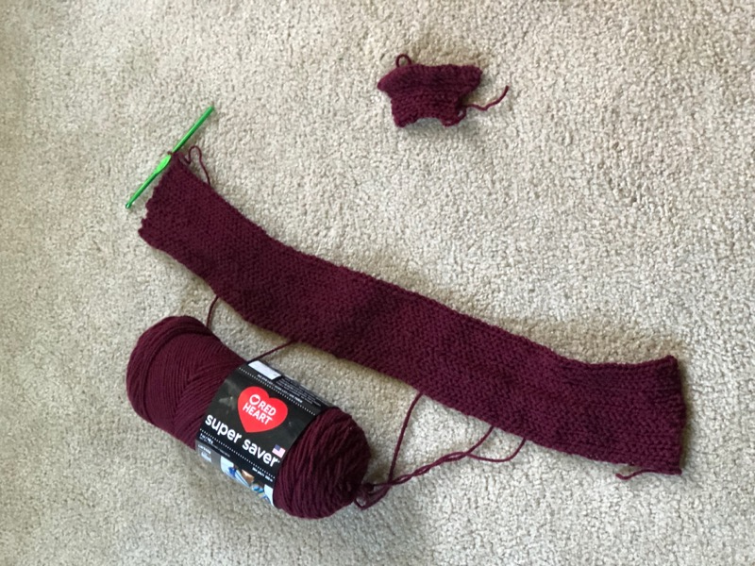
Crochet

Slide 9
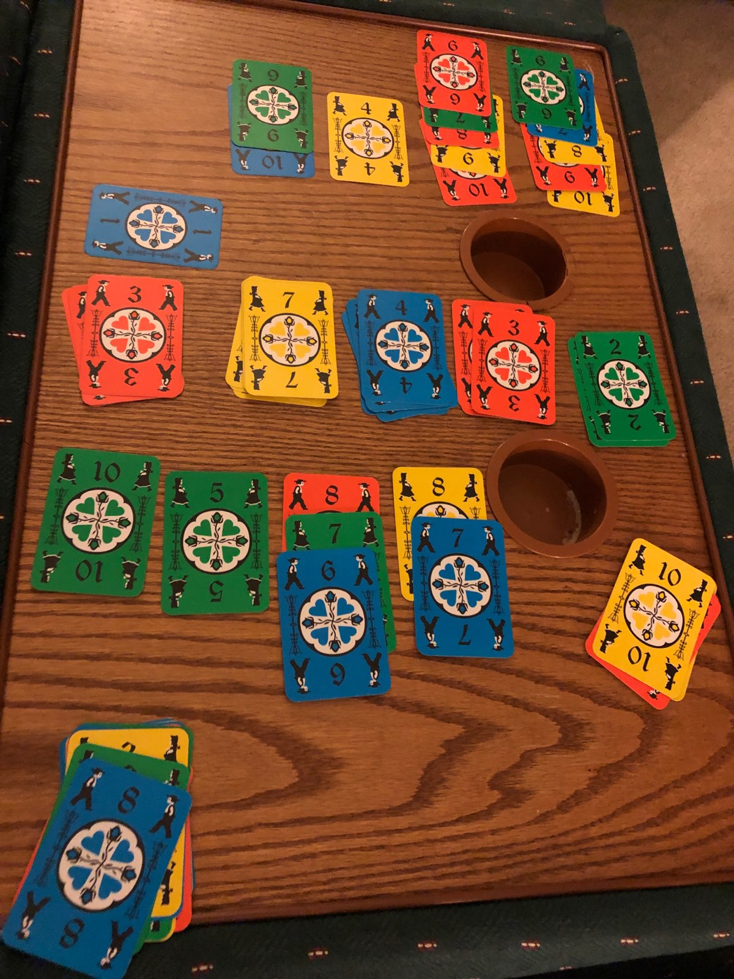
Board games/Cards

Slide 10
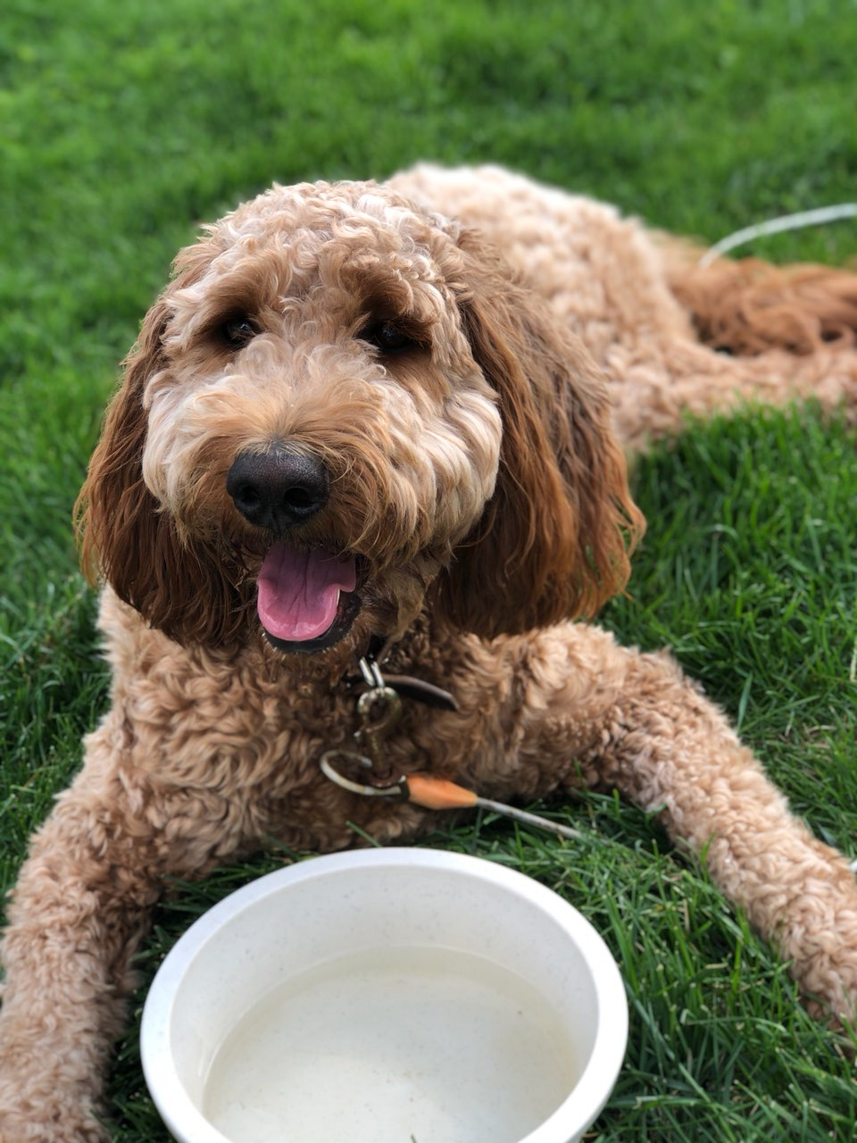
Walks with Baker

Slide 11
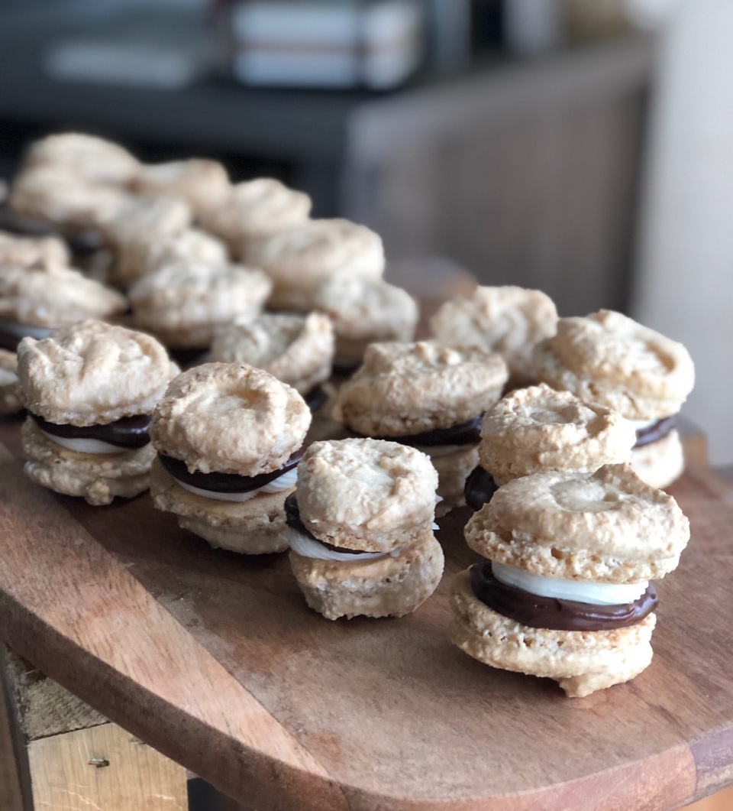
Baking

Slide 12
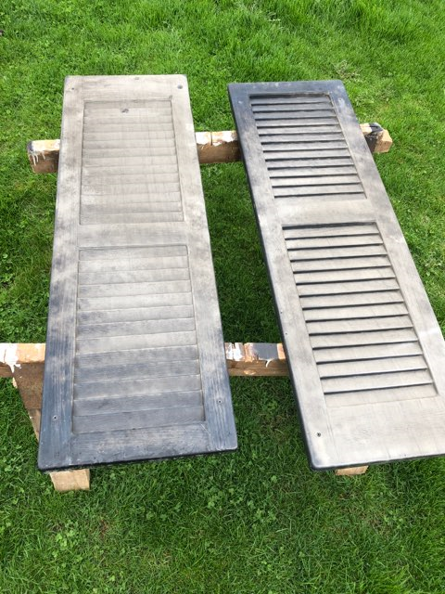
House Renovations

Slide 13
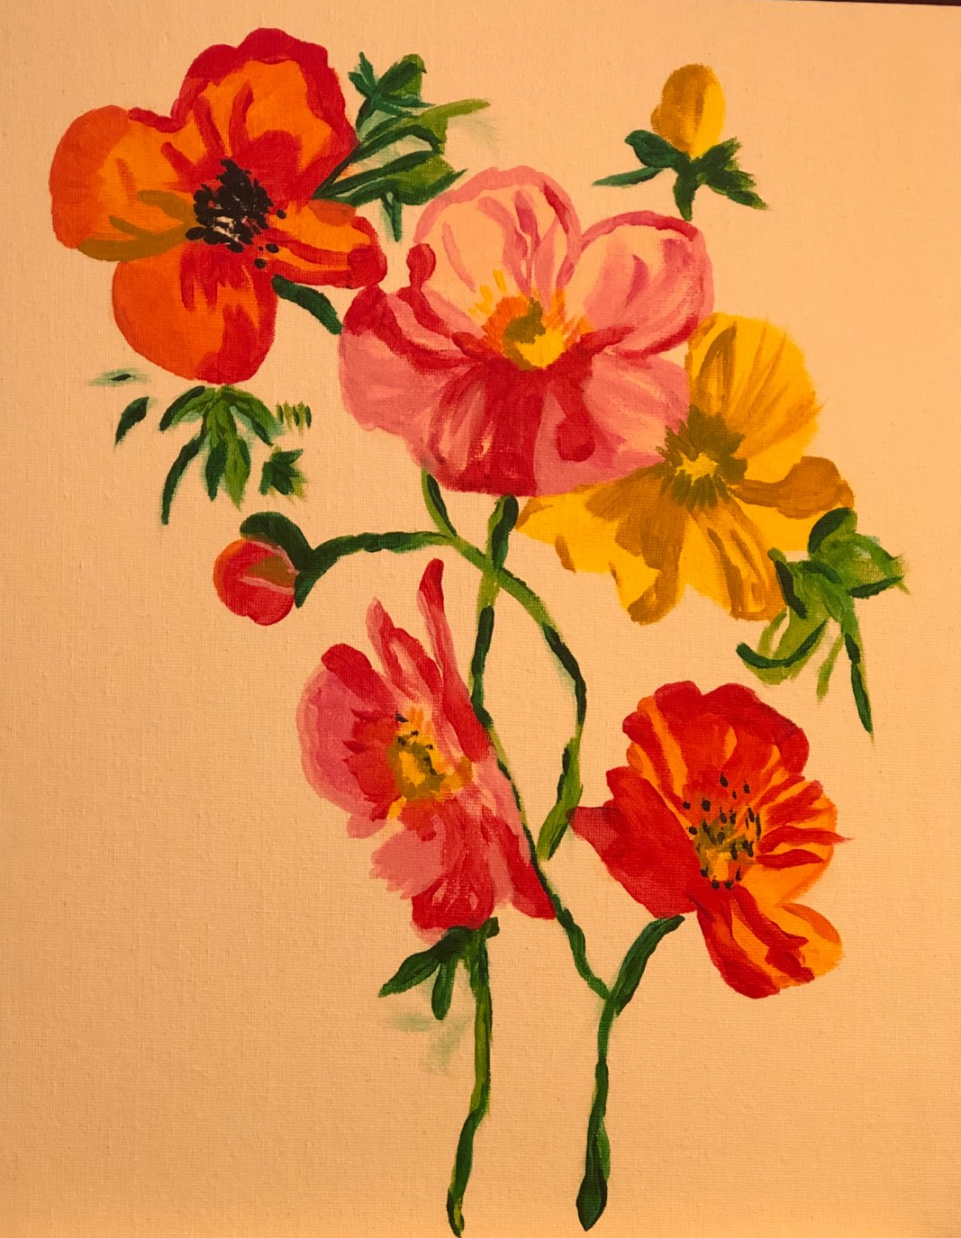
Painting

Slide 14
Zoom with Friends & Family

Slide 15
Go live your best life

